Slide 1
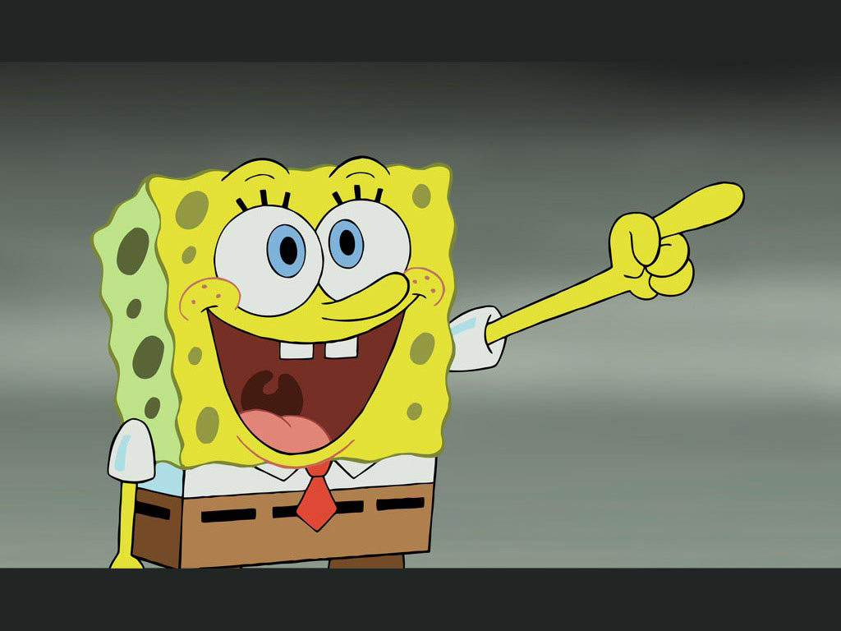
learn with sponge bob
TO BE

Slide 2

How is he?
is
He __ happy.

Slide 3
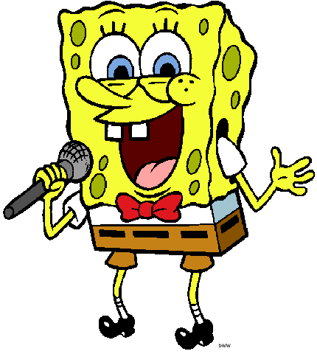
Is he a doctor?
No, he _____ !
He ___ a singer.
isn’t
is

Slide 4
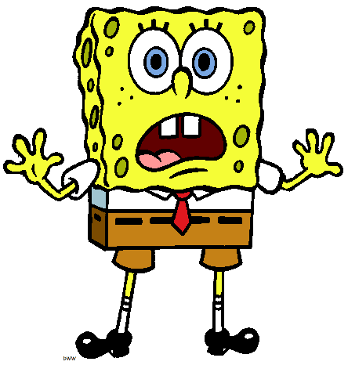
What’s wrong Sponge Bob?
I ____ scared!
am

Slide 5
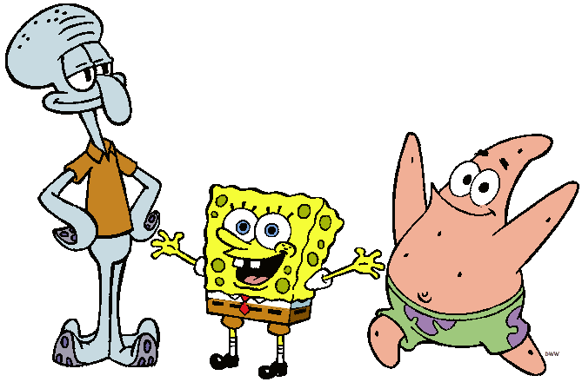
Who are they?
They ____ friends.
are

Slide 6
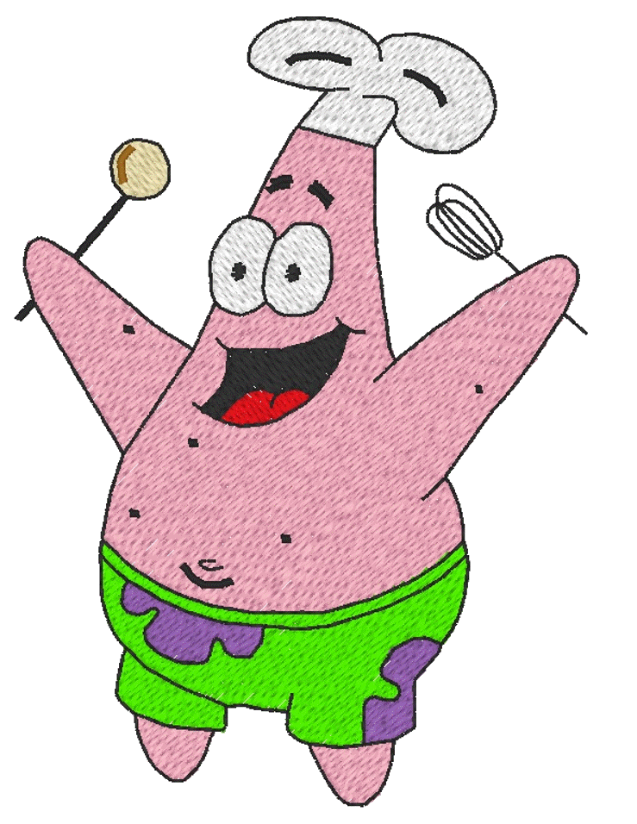
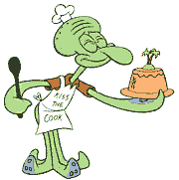
Are they firemen?
No, they ______ !
They ____ cooks.
aren’t
are

Slide 7
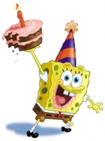
How old are you?
I ____ one year old!
am

Slide 8
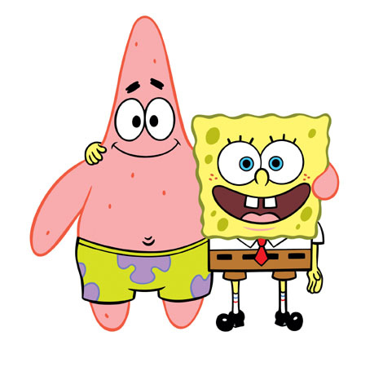
How are you today?
We ____ happy!
are

Slide 9
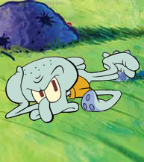
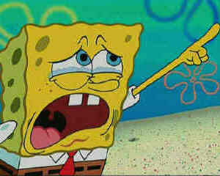
Are they happy?
aren’t
No, they ______ !
I ____ upset!
am
He ___ sad!
is

Slide 10
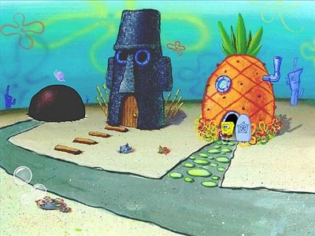
Where are they from?
They _______ from Turkey!
They _______ from Bikini Bottom!
aren’t
are

Slide 11
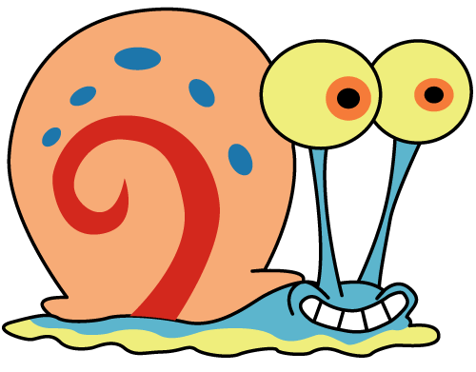
Review – Long forms
I
am
I
am not
You
are
You
are not
He
is
He
is not
She
is not
She
is
It
is
It
is not
We
are
We
are not
They
are
They
are not

Slide 12
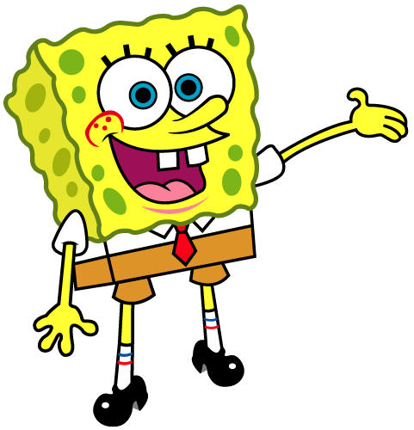
Review – Short forms
I
‘m
I
‘m not
You
‘re
You
aren’t
He
‘s
He
isn’t
She
isn’t
She
‘s
It
It
isn’t
‘s
We
‘re
We
aren’t
They
‘re
They
aren’t

Slide 13
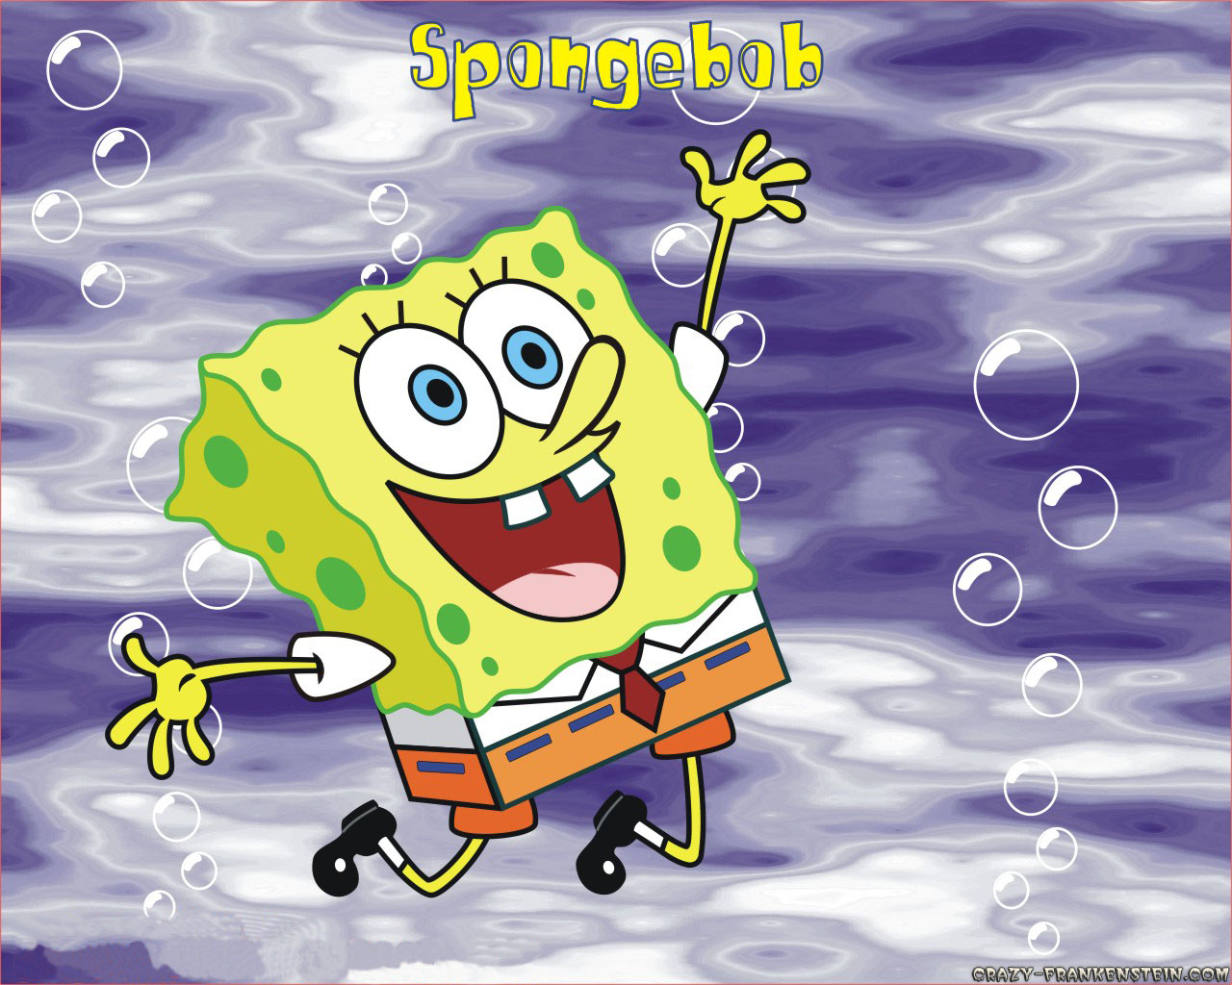
The end!

